Slide 1

presents
General Championship
OpenSoft
TEAM 2025104

Slide 2

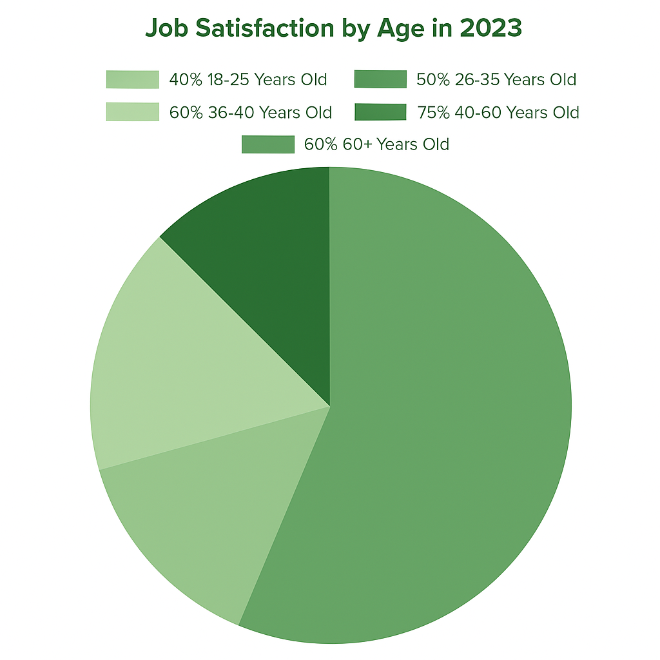
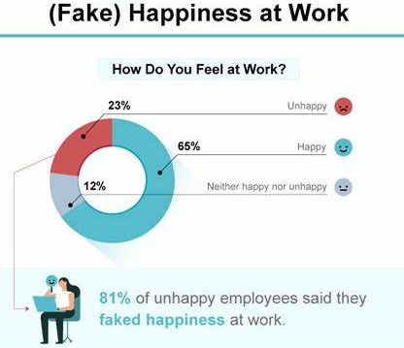
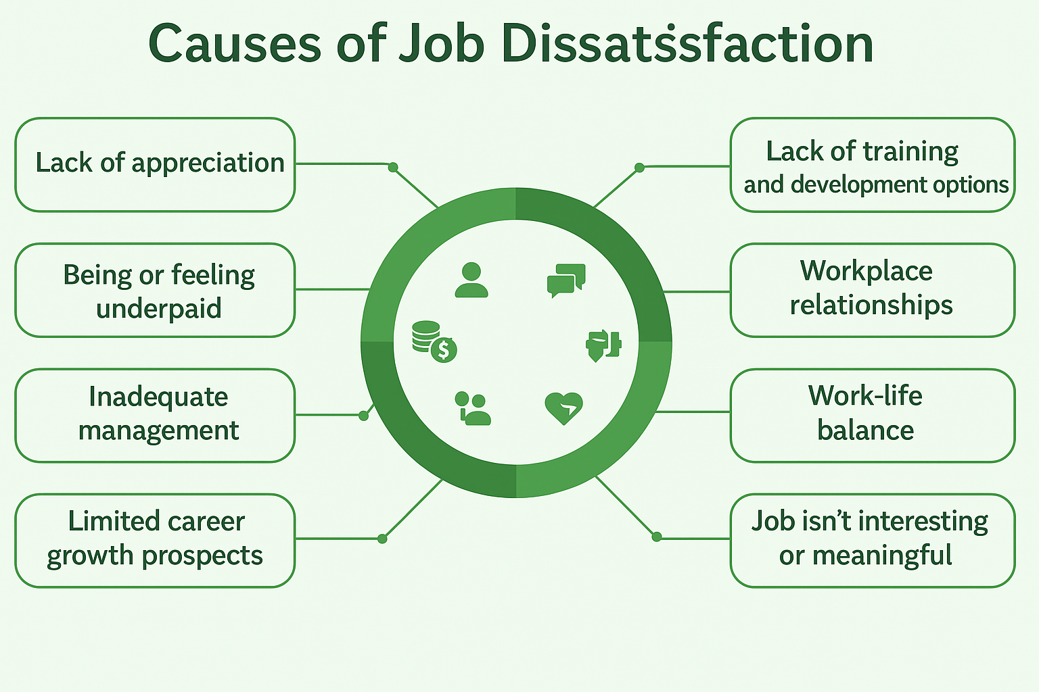

Problem Overview
Job dissatisfaction lowers productivity
Employees often pretend to be happy to meet workplace expectations
Despite this facade, they feel unfulfilled and disengaged
Seek work-life balance and stability
Value career growth and learning
Appreciate development, mentorship, and recognition
Leads to burnout and low job satisfaction
Reduces productivity and morale
Problem Overview
Naive Approach
Our Solution
Future Work

Slide 3







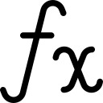



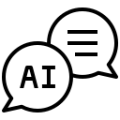

Naive Approach
Limitations
Motivation Dilution: Over-reliance on material rewards can reduce intrinsic motivation
Data Reliability: Self-reported data may be biased or inconsistent
Context Misinterpretation: AI may misinterpret context or emotions without sufficient nuance
Reaward
Regular gift rewards can be given to employees
Incentives can help boost workplace motivation
Leisure rewards like movie or vacation tickets help refresh the mind
Open conversations often lead to effective problem-solving
EQ/RQ
Conduct surveys to gather emotional and relational insights
Ask targeted questions to identify key behavioral parameters
Build an empirical formula based on the collected parameters
Applying the formula can yield meaningful and actionable results
Potential Solution
Balanced Recognition: Combine rewards with recognition and personal growth opportunities to maintain balance.
Cross-Validation: Cross-validate responses with behavioral observations and peer feedback.
Human-AI Synergy: Regularly fine-tune AI models and include a human-in-the-loop for critical evaluations.
Using AI
Use pre-trained industry AI models for employee interaction
Provide well-crafted prompts to guide meaningful conversations
The chatbot engages employees to assess mental well-being
Insights gathered can help shape impactful wellness strategies
Problem Overview
Naive Approach
Our Solution
Future Work

Slide 4
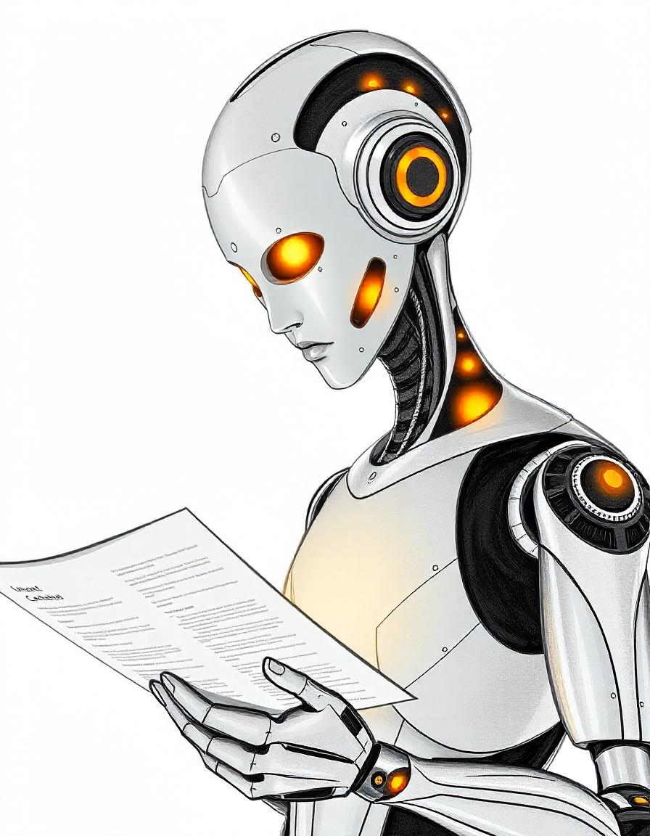
Our Solution
Employee Classifier
Intense Tracking
An AI Chatbot
Collects mood updates to monitor emotional well-being
Exact Reasons
Data Trained
Flagged
Offering tips to boost their mood and enhance overall wellbeing
Unflagged
Urgent Attention
Employee Exclusive
Responds empathetically based on user sentiment
Measures Take
HR Involvement
Suggests Required Steps
I'm glad to hear that. However, I noticed that you've been putting in quite a lot of hours lately, and your meeting schedule seems pretty packed. How are you handling your current workload?
Notifies HR
Generates Average Mood Report
Emotionally Intelligent Answers
Quality Talks
Push notifications
Wellness Tips
Problem Overview
Naive Approach
Our Solution
Future Work

Slide 5
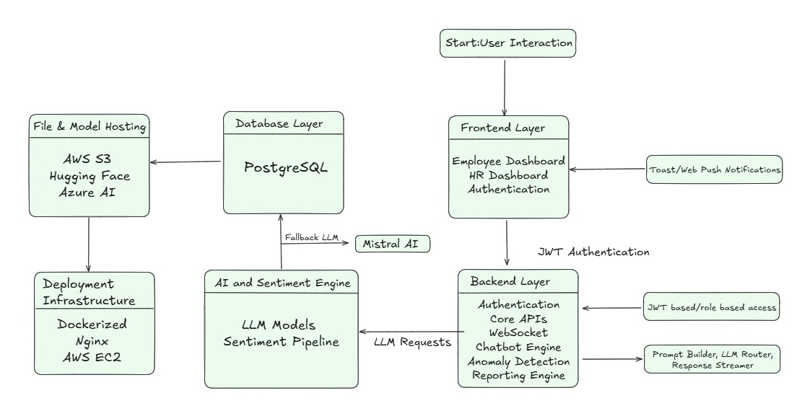
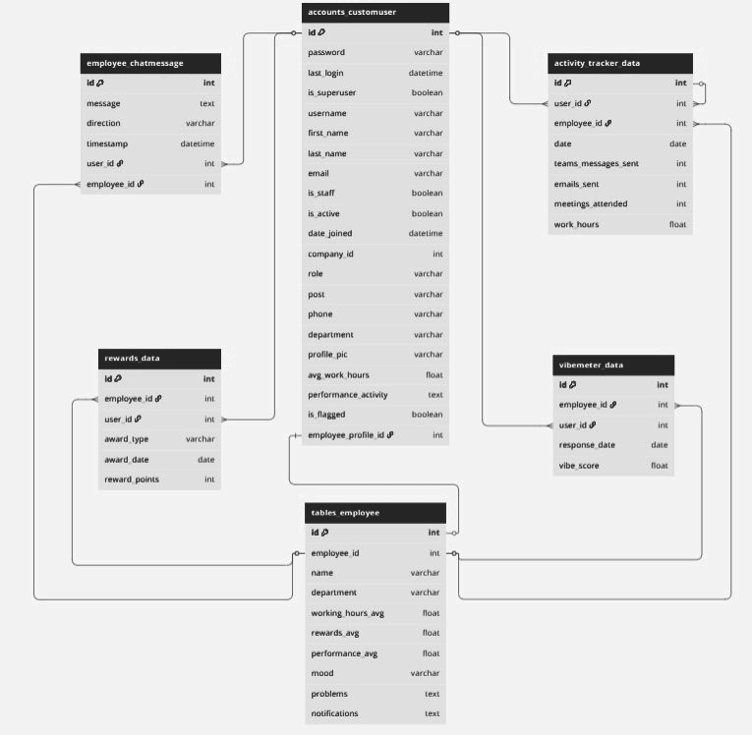
System Architecture and ER Diagram
System Architecture
Employee Engagement
Users access the dashboard
Backend handles logic and AI requests
Sentiment is processed via LLMs
Data is stored in PostgreSQL
Hosted and deployed on cloud infrastructure
User Registration & Login
Daily Activity Monitoring
Real-Time Communication Logs
Employee Sentiment Analysis
Reward Allocation
Performance Aggregation
Problem Overview
Naive Approach
Our Solution
Future Work

Slide 6
Data Processing
Data Preprocessing
Anomaly Detection
Explainability using SHAP
Employees' communication habits & responsiveness reflecting behavior
Work patterns include attendance, leave trends, & productivity times
Performance measured through task completion and output quality
Anomaly score becomes more negative with higher anomaly levels
Higher sensitivity identifies more employees as anomalies
Adjusting sensitivity changes anomaly detection outcomes
SHAP values are computed using a TreeExplainer for the Isolation Forest
Negative SHAP values indicate factors contributing to distress
Focus is placed on these negative values for interpretation
Methodology
Fine Tuning Strategy
Intelligent Conversation
Feedback Summarisation
Generates HR reports with insights from distressed employee data
AI Models
Mistral-7B-Instruct
QLoRA
Dynamic Chat Management
Tree-of-Thought Reasoning
HR-Specific Prompt Engineering
Employee Context Generation (output)
Employee Context Generation
Problem Overview
Naive Approach
Our Solution
Future Work

Slide 7




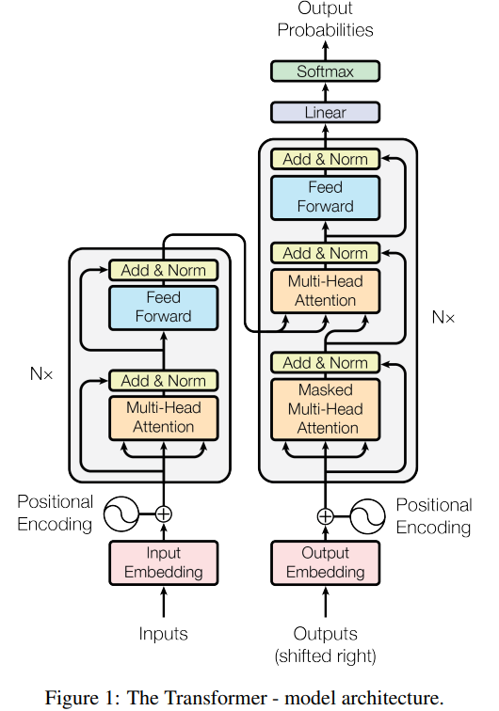


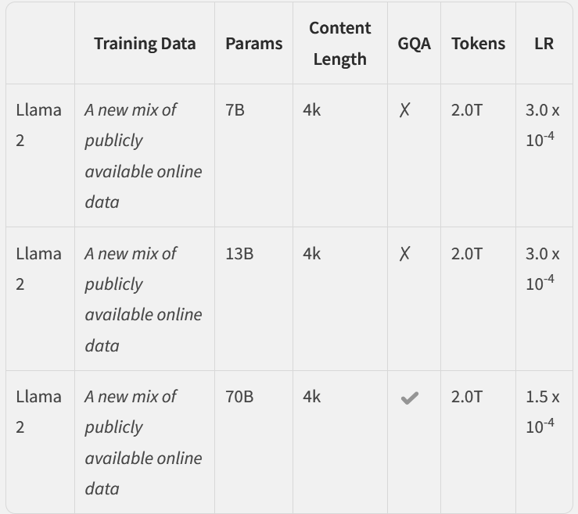
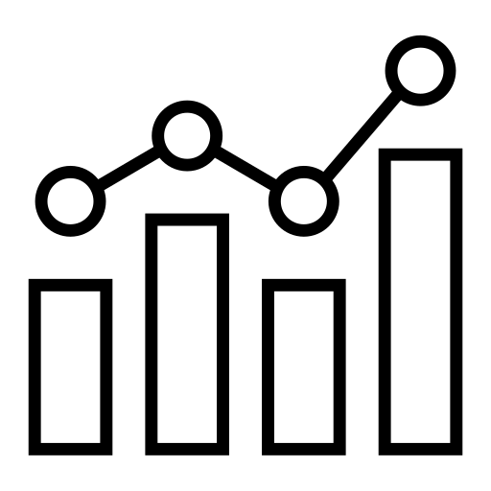



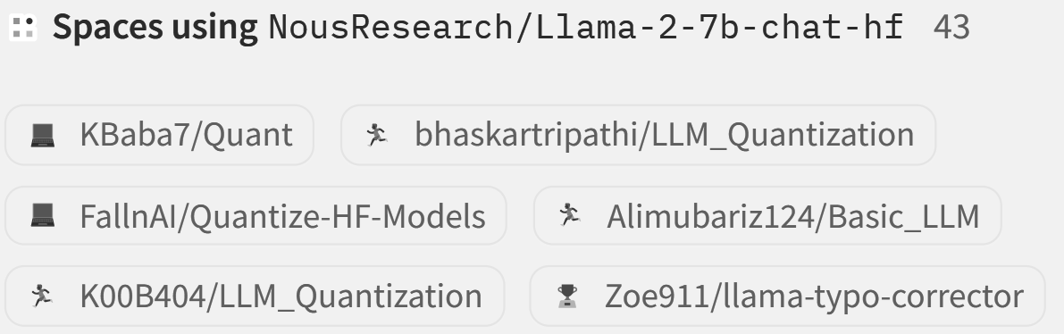
Question Surveying & Model Scouting
Identify at-risk employees through behavioral metrics
Model Scouting
Flags generated for
Concurrency is being handled
Transformers
Llama 2
Work Hours
High workload (150+ hrs/month)
Model size : 6.74B params
Tensor type : FP16
Model size : 7.24B params
Tensor type : BF16
Communication load
Activity Log consistency
Context length: 4k tokens.
Optimized for reasoning and safety.
Low engagement (<70% team comms)
Leave patterns
Vibe Score trends
Abnormal leave patterns
Reward Point decay
Process flow
Load the cleaned dataset
Calculate Baseline Averages
Select Focus Group
Detect Deviations
Flag and Summarize Concerns
Generate Questions
Problem Overview
Naive Approach
Our Solution
Future Work

Slide 8


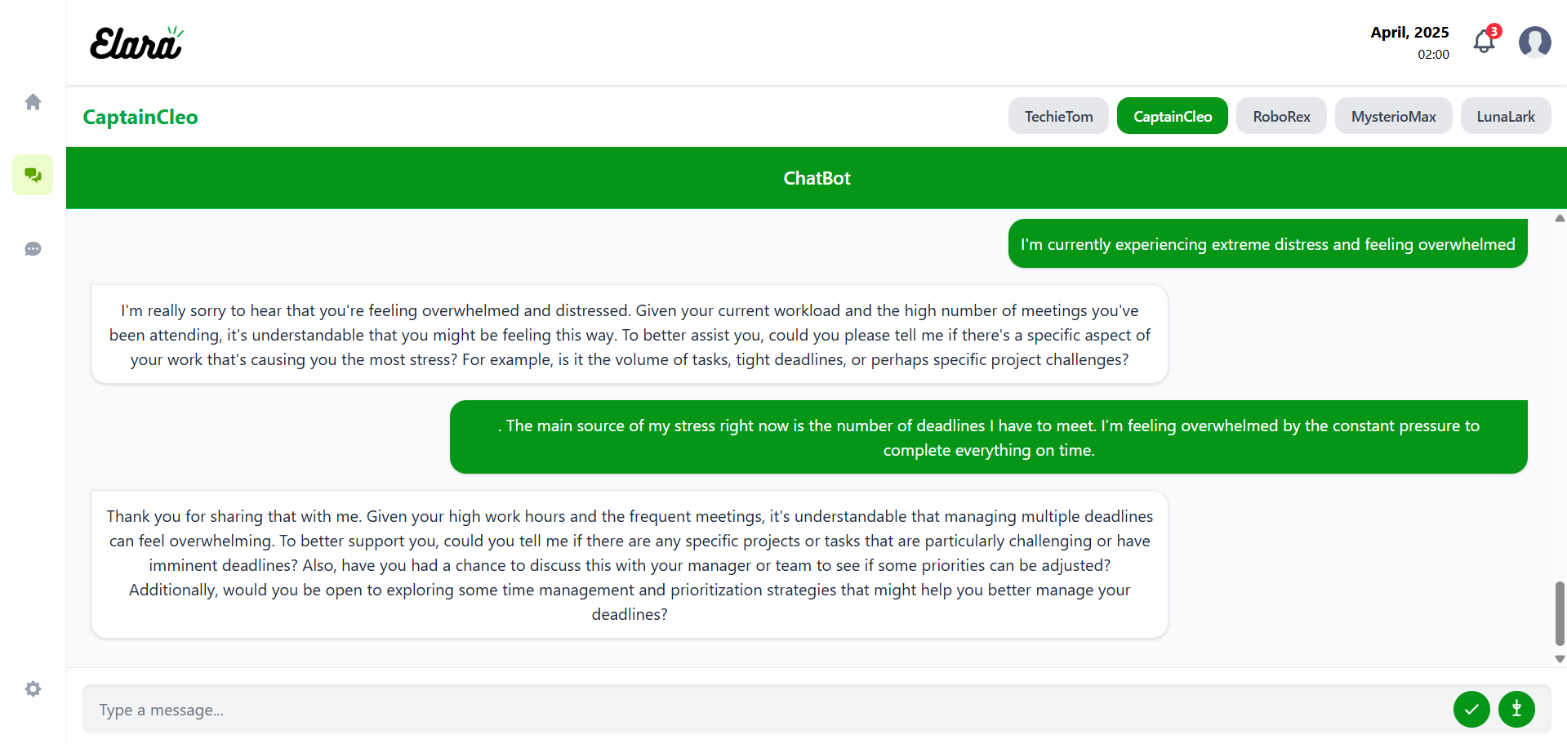




Chatbot and Features
Taking employee mood overview each alternate day
Generates report of the employee mood status
Notifies HR of declining employee mental health.
Chatbot
Intuitive User Interface : Seamlessly designed for easy navigation and user engagement
Instant Alerts for Flagged Employees : Chatbot promptly notifies employees showing concerning patterns
Data-Driven Insights : Bot analyzes employee data to identify sentiment and engagement drivers
Personalized Q&A Bank : Tailored answers for employee-specific queries and situations
Summarized Report: Automatically shares a concise summary of employee performance with HR
Problem Overview
Naive Approach
Our Solution
Future Work

Slide 9
Technologies and Tools
Tech Stacks
React.js
Used to build a responsive and interactive front end for the chatbot interface, ensuring a smooth user experience
Django
Powers the backend logic and API services for handling user queries, document processing, and chatbot workflows
Amazon web services
Cloud infrastructure for hosting, secure document storage, and scalable backend services
mistral & ollama
Enable local deployment and inference of open-source language models, forming the core of the chatbot’s intelligent response system
Channels:- It extends Django for WebSockets and async support.
Reportlab :- A library for generating PDFs and graphics
Daphne :- A framework for data pipelines, HPC, and ML.
Gunicorn :- A WSGI server that forwards requests to Python apps.
PyJWT :- A Python library to work with JSON Web Tokens.
Psycopg2 :- PostgreSQL database adapter for Python.
Pillow :- A Python Imaging Library
Tailwind :- Utility-first CSS framework
React-router-dom :- Routing library for React
React-hot-toast :- Library for displaying toast notifications
Recharts :- Charting library for React
Axios :- HTTP client library
Framer-motion :- Animation library
mui/material :- Component library
Libraries/Frameworks
Problem Overview
Naive Approach
Our Solution
Future Work

Slide 10
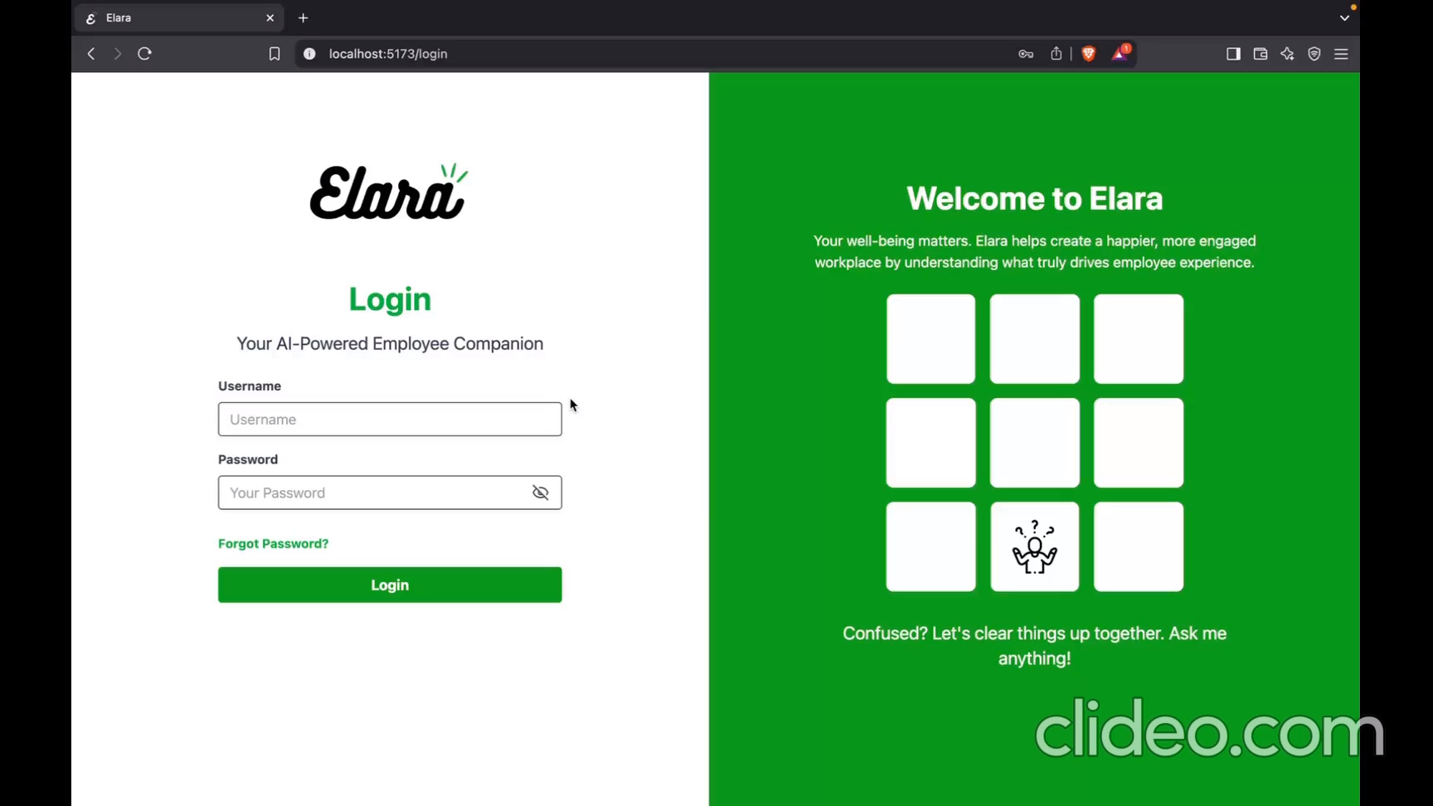
Video Demonstration
Problem Overview
Naive Approach
Our Solution
Future Work

Slide 11






Conclusion and Future scope
Conclusion
Future scopes
Successfully fine-tuned Llama 2-7B with QLoRA for a domain-specific chatbot.
Personalized Mental Health Recommendations
Integration with HR Systems (HRMS, Payroll, Attendance)
Track mood and activity trends
Deliver personalized tips to enhance well-being and prevent employee burnout.
Integrate with platforms like SAP, Zoho, or Workday.
Enable leave requests, payslip access, and attendance tracking via chatbot to simplify HR tasks.
Achieved real-time mood tracking and sentiment analysis via WebSockets.
Developed interactive dashboards for both employees and HR with actionable insights.
AI-Powered Employee Retention Insights
Crisis Escalation Protocols
Ensured efficient performance on low-resource devices through model quantization.
Analyze mood and performance data to detect disengagement and predict attrition risks.
Alert HR for early intervention and preventive action.
Detect distress signals or extreme negative sentiment.
Alert HR or responders and offer emergency support.
Deployed a lightweight, scalable solution ready for real-world organizational use.
Our Solution
Future Work
Problem Overview
Our Solution
Future Work
Problem Overview
Naive Approach
Naive Approach

Slide 12
Thank you
THANK YOU
"Problems never disturb us, it’s our reaction that counts"

